Slide 1
K-Means Algorithm
Submitted By : - Lalit Petkule
Seat No : - T218046
PRN : - 0120190419

Slide 2
Machine Learning
Application of artificial intelligence
Study of self-learning computer algorithms
Improve from experience
Algorithms build model - > Models are trained
Applications :
Spam filtering
Speech Recognition
Computer Vision
Medicine

Slide 3
Unsupervised learning
Models are not supervised using training dataset
Models are trained using unlabeled dataset
Models itself find hidden patterns and insights
Goal of unsupervised learning –
Find underlying structure of dataset
Group data according to similarity
Present that data in compressed format

Slide 4
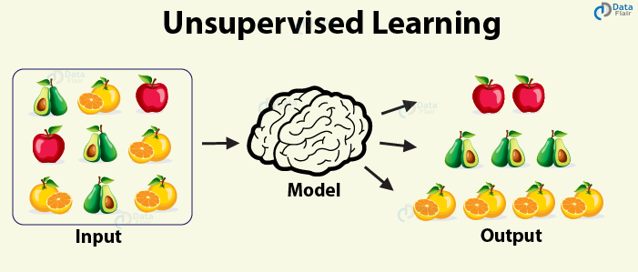
Unsupervised learning

Slide 5
K-means algorithm
Clustering algorithm
Unsupervised ML algorithm
Centroid-Based algorithm
Minimize the sum of distance between the points and their respective cluster centroid
Application of clustering –
Customer segmentation
Document clustering
Image segmentation
Recommendation engines

Slide 6
Steps of k-means clustering algorithm –
step 1 – choose the number of clusters K
Step – select k random points from the data as centroids
Step 3 – assign all the points to the closest cluster centroid
Step 4 – recompute the centroid of newly formed clusters
Step 5 – repeat step 3 and 4
Stopping criteria for k-means clustering –
Centroid of newly formed cluster do not change
Point remain in same cluster
Maximum number of iteration are reached

Slide 7
Real life applications of k-means clustering algorithms –
Customer segmentation
Insurance fraud detection
Disease diagnosis
Rideshare data analysis
Cyber-profiling criminals
Call record detail analysis
Document classification
Identifying crime localities

Slide 8
Limitations of k-means algorithm –
The clusters are of unequal size or density
The clusters are non-spherical
There are outliers in the data

Slide 9
Thank You

